Slide 1


John Leeman
November 2, 2022

Slide 2

Outline
Executive Summary
Introduction
Methodology
Results
Conclusion
Appendix

Slide 3
Executive Summary
Summary of methodologies
Data collection using API, Web Scraping and Data Wrangling
Exploratory Data Analysis with SQL
Data Visualization with Folium
Machine Learning Predictive Analysis
Summary of all results
Data Analysis results
Screenshots of Analytic Visualizations
Predictive Analysis results

Slide 4
Introduction
Project background and context
SpaceX advertises Falcon 9 rocket launches on its website, with a cost of 62 million dollars; other providers cost upward of 165 million dollars each, much of the savings is because SpaceX can reuse the first stage. We want to determine if the first stage will land, we can determine the cost of a launch. This information can then be used to bid against SpaceX for a rocket launch.
Problems you want to find answers
What factors into a successful rocket landing?
What interactions of these factors help determine a successful landing?
What are the best operating conditions necessary to predict a successful landing?

Slide 5

Section 1

Slide 6
Methodology
Executive Summary
Data collection methodology:
Data was collected using SpaceX API and web scrapping Wikipedia
Perform data wrangling
Data was processed using one-hot encoding for categorical features
Perform exploratory data analysis (EDA) using visualization and SQL
Perform interactive visual analytics using Folium and Plotly Dash
Perform predictive analysis using classification models
How to build, tune, evaluate classification models

Slide 7
Data Collection
Data was collected using the response from the SpaceX Rest API
The response content was decoded as JSON using .json() function call and turn it into a pandas dataframe using .json_normalize().
The data was then cleaned and missing values were accounted for.
Web scraping was done against Wikipedia for Falcon 9 launch records using BeautifulSoup to extract launch records. The html was parsed and saved to a Pandas Dataframe which was used for analysis.

Slide 8
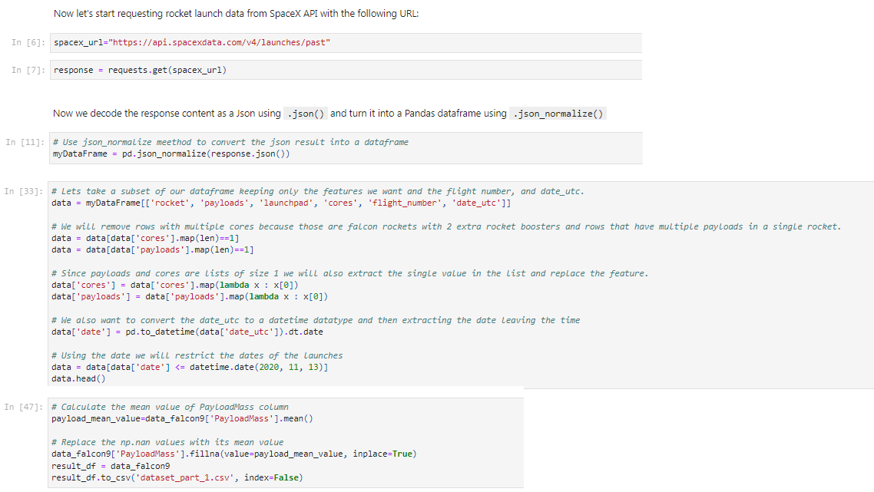
Data Collection – SpaceX API
The SpaceX API was used to collect data. It was then cleaned and formed.
Json_normalize() was used to convert data to a dataframe to be used in analysis.
GitHub URL:
CapstoneRepo/Applied Data Science Capstone Notebook.ipynb at main · jleeman22/CapstoneRepo (github.com)
Place your flowchart of SpaceX API calls here

Slide 9
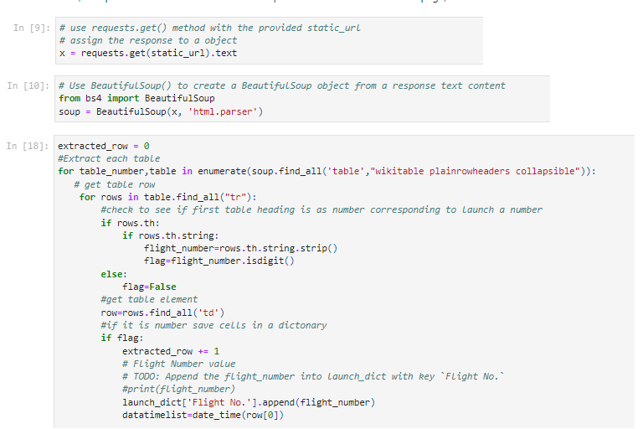
Data Collection - Scraping
Request Falcon9 launch data from Wikipedia URL
Use BeautifulSoup on the response text
Extract the data from the html
CapstoneRepo/Capstone Web Scrapping.ipynb at main · jleeman22/CapstoneRepo (github.com)
Place your flowchart of web scraping here

Slide 10

Data Wrangling
Data wrangling is the process of cleaning data to facilitate it’s use in Exploratory Data Analysis (EDA).
The number of launches at each site was calculated, as well as the number and occurrences of each orbit type.
We then created a landing outcome label from outcome column for additional analysis and machine learning. The results were exported to a CSV file.
CapstoneRepo/Data Wrangling EDA.ipynb at main · jleeman22/CapstoneRepo (github.com)

Slide 11


EDA with Data Visualization
EDA with Data Visualization
We explored the data by visualizing the relationship between flight number and launch Site, payload and launch site, success rate of each orbit type, flight number and orbit type, the launch success yearly
CapstoneRepo/EDA with Visualization lab.ipynb at main · jleeman22/CapstoneRepo (github.com)
11

Slide 12
EDA with SQL
Used EDA with SQL to get a better understanding of the dataset. Queries were written to find:
The names of unique launch sites in the space mission.
The total payload mass carried by boosters launched by NASA (CRS).
The average payload mass carried by booster version F9 v1.1.
The total number of successful and failure mission outcomes.
The failed landing outcomes in drone ship, their booster version and launch site names.
The ranks of the landing outcome counts or successes for given periods of time.
CapstoneRepo/EDA with SQL Lab.ipynb at main · jleeman22/CapstoneRepo (github.com)

Slide 13
Build an Interactive Map with Folium
We wanted to visualize the launch data in an interactive folium map with marked launch sites, mapped objects such as markers, circles, lines to indicate the success or failure of launches.
We assigned the dataframe launch outcomes (failure or success) to class 0 and 1 (0 for failure 1 for success) with red and green markers on the map in MapCluster().
We calculated the distances between a launch site to its proximities to find answers to some questions:
Are launch sites near railways, highways and coastlines?
Are launch sites close to nearby cities?
CapstoneRepo/Visual Analytics with Folium lab.ipynb at main · jleeman22/CapstoneRepo (github.com)

Slide 14
Build a Dashboard with Plotly Dash
Built an interactive dashboard with Plotly dash which allowed users to select different inputs.
Plotted pie charts showing the total launches by a certain sites.
Plotted scatter graph showing the relationship with Outcome and Payload Mass (Kg) for the different booster version.
GitHub URL:CapstoneRepo/EDA with Visualization lab.ipynb at main · jleeman22/CapstoneRepo (github.com)

Slide 15
Predictive Analysis (Classification)
Building the model
Loaded the data using numpy and pandas
Transformed the data and split it into training and testing
Set parameters and algorithms to tune using GridSearchCV
Evaluate the model
Check accuracy of each model
Get tuned hyperparameters for each type of algorithms
Improve the model
Use feature engineering and algorithm tuning
Find the best performing classification model
GitHub URL:CapstoneRepo/Machine Learning Prediction lab.ipynb at main · jleeman22/CapstoneRepo (github.com)

Slide 16
Results
Exploratory data analysis results
Interactive analytics demo in screenshots
Predictive analysis results

Slide 17

Section 2

Slide 18

Flight Number vs. Launch Site
From the plot, we found that the larger the flight amount at a launch site, the greater the success rate will be.

Slide 19
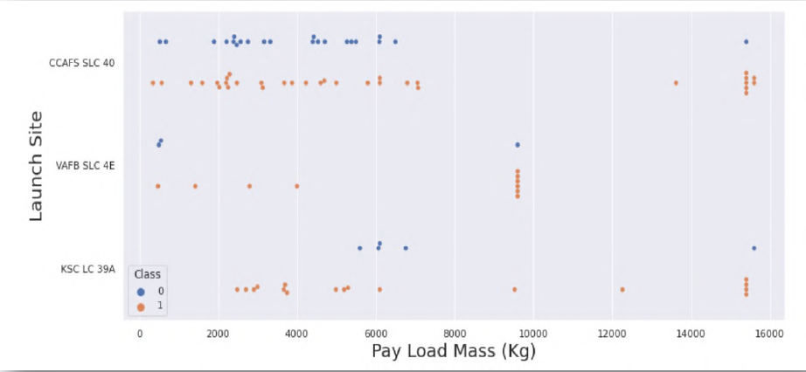
Payload vs. Launch Site
The scatter plot shows that if the payload is greater, the rate of success increases drastically.

Slide 20

Success Rate vs. Orbit Type
From the plot, we can see that ES-L1, GEO, HEO, SSO, VLEO had the most success rate.

Slide 21

Flight Number vs. Orbit Type
The plot below shows the Flight Number vs. Orbit type. We observe that in the LEO orbit, success is related to the number of flights whereas in the GTO orbit, there is no relationship between flight number and the orbit.

Slide 22

Payload vs. Orbit Type
We see that with heavy payloads, the successful landing are more for PO, LEO and ISS orbits.

Slide 23
Launch Success Yearly Trend
Observing the plot, we see that success rate from 2013 kept on increasing until 2020

Slide 24
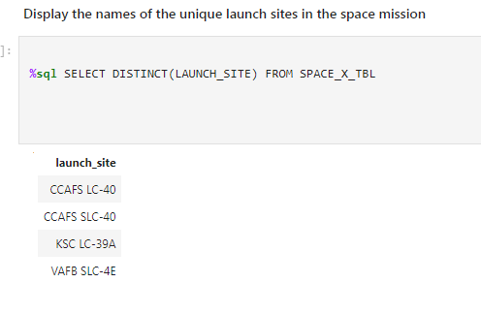
All Launch Site Names
Use the key word DISTINCT to show only unique launch sites from the SpaceX data.

Slide 25
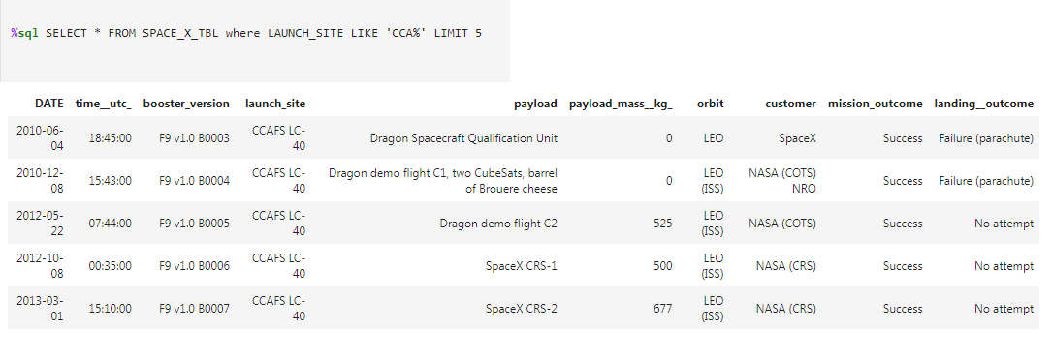
Launch Site Names Begin with 'CCA'
5 records where launch sites begin with `CCA

Slide 26
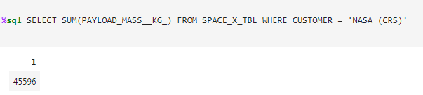
Total Payload Mass
The total payload carried by boosters from NASA

Slide 27
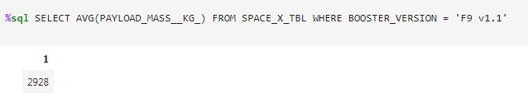
Average Payload Mass by F9 v1.1
The average payload mass carried by booster version F9 v1.1

Slide 28
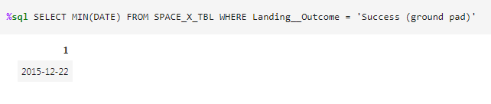
First Successful Ground Landing Date
The dates of the first successful landing outcome on ground pad

Slide 29
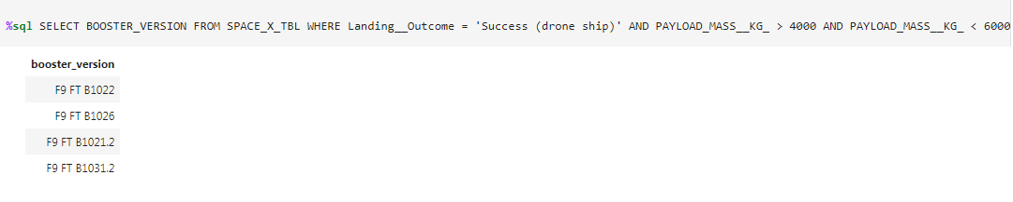
Successful Drone Ship Landing with Payload between 4000 and 6000
The names of boosters which have successfully landed on drone ship and had payload mass greater than 4000 but less than 6000

Slide 30
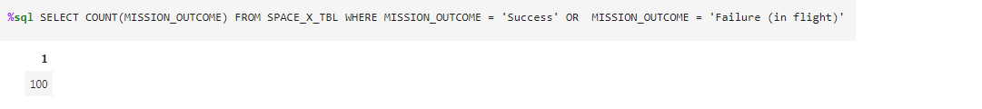
Total Number of Successful and Failure Mission Outcomes
The total number of successful and failure mission outcomes

Slide 31
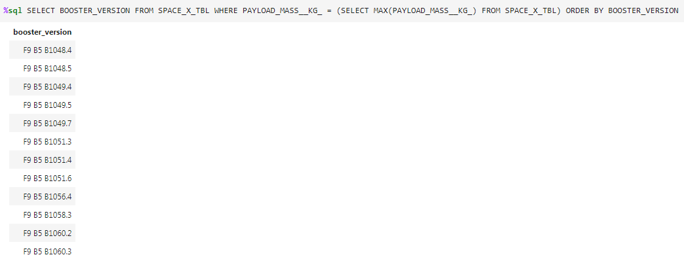
Boosters Carried Maximum Payload
The names of the booster which have carried the maximum payload mass

Slide 32
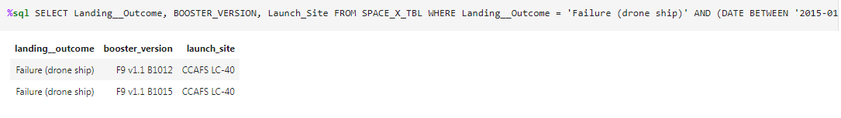
2015 Launch Records
The failed landing_outcomes in drone ship, their booster versions, and launch site names for in year 2015

Slide 33
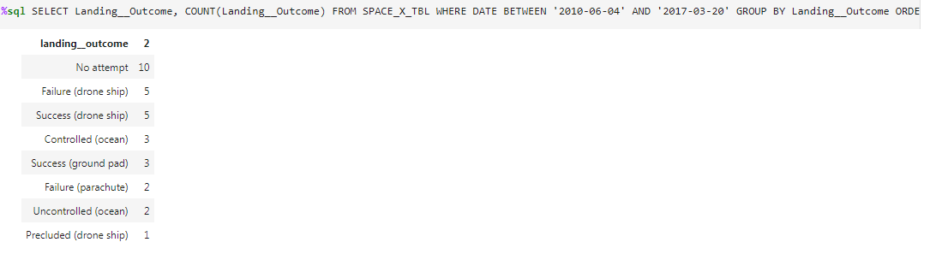
Rank Landing Outcomes Between 2010-06-04 and 2017-03-20
Rank the count of landing outcomes (such as Failure (drone ship) or Success (ground pad)) between the date 2010-06-04 and 2017-03-20, in descending order

Slide 34

Section 3

Slide 35
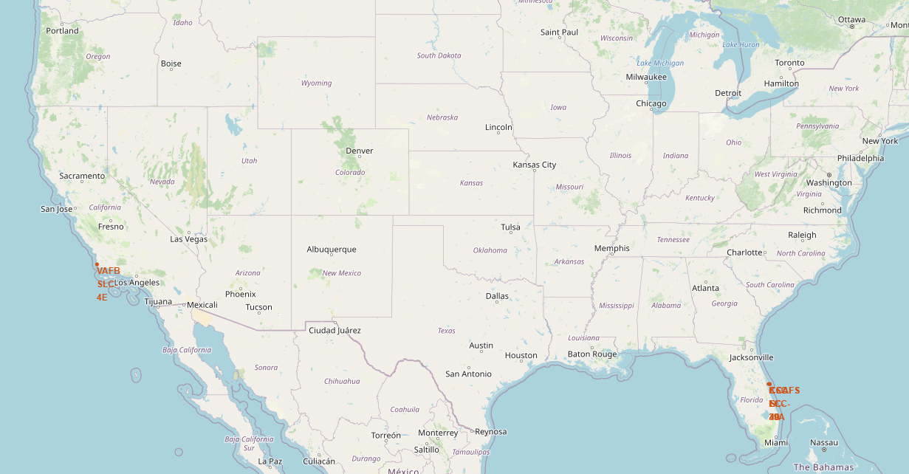
SpaceX Launch Site Locations
The map shows that all of the SpaceX launch sites are located on the coasts in the United States.

Slide 36

Markers Showing Launch Sites with Colored Labels

Slide 37

Launch Site’s Distance to Landmarks

Slide 38

Section 4

Slide 39
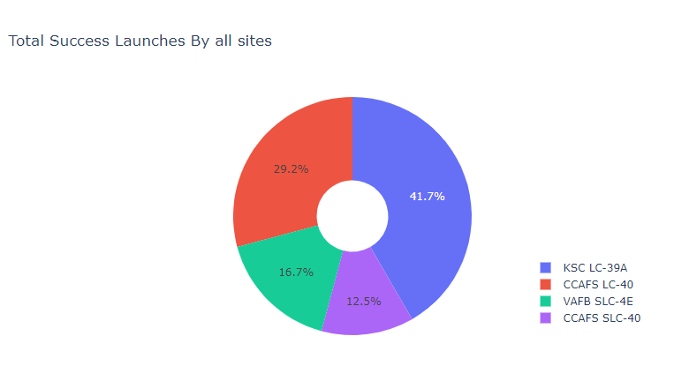
Success Percentage of Each Launch Site
We see that KSC LC-39A had the most successful launches of all of the sites.

Slide 40
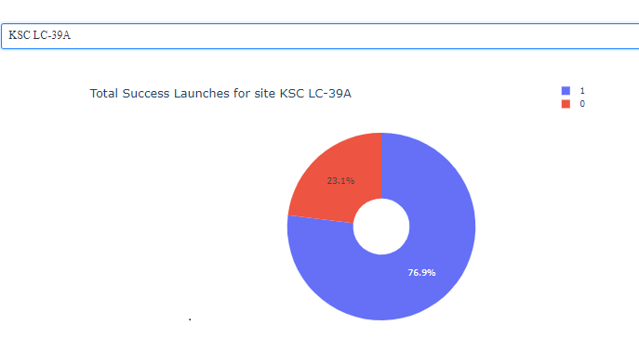
Launch Site KSC-39A has the highest launch success ratio
KSC LC-39A achieved a 76.9% success rate and a 23.1% failure rate

Slide 41

Payload vs. Launch Outcome Scatter Plot

Slide 42

Section 5

Slide 43

Classification Accuracy
The decision tree classifier is the model with the highest classification accuracy

Slide 44

Confusion Matrix
The confusion matrix for the decision tree classifier shows that the classifier can distinguish between the different classes. The major problem is the false positives .i.e., unsuccessful landing marked as successful landing by the classifier.

Slide 45
Conclusions
We can conclude that:
The larger the amount of flights at a launch site, the greater the success rate at a launch site.
Launch success rate for SpaceX launches increased from 2013 until 2020.
Orbits ES-L1, GEO, HEO, SSO, VLEO had the most success rate.
KSC LC-39A had the most successful launches of any sites: 76.9%.
The Decision tree classifier was identified as the best machine learning algorithm for this task/dataset.

Slide 46


